Slide 1
Continuous Processes

Slide 2
The Typical Non-Continuous Integration (CI) Approach
A feature to be developed has been specced out and developers are asked to start working on it
A branch in version control for the feature is made
On completion, branch is merged with master
QA tests system, eventually giving sign-off
Code is pushed to production environment

Slide 3
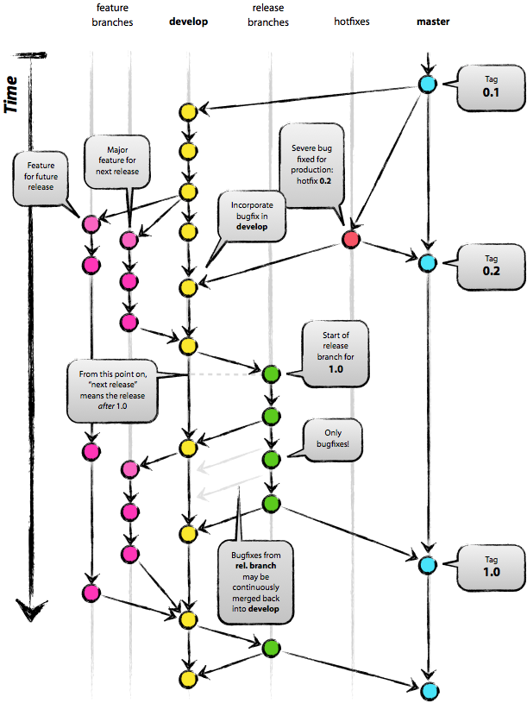

Problems Typical Approach Can Cause
A branch in version control for the feature is made
compared to

Slide 4
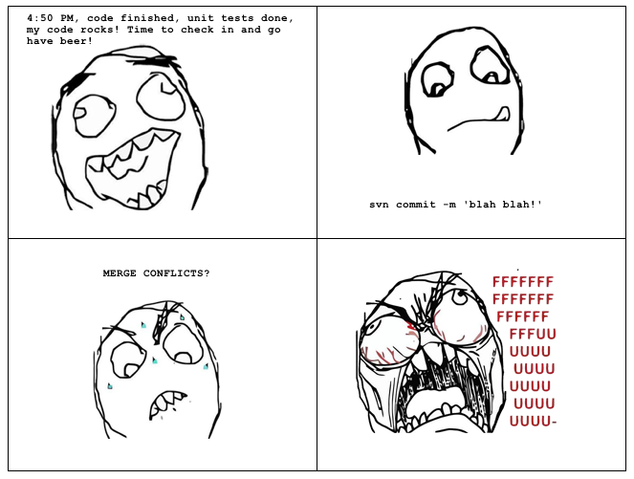
Problems Typical Approach Can Cause
On completion, branch is merged with master

Slide 5
Problems Typical Approach Can Cause
QA tests system and eventually gives sign-off
Where are the automated tests?
What needs testing? Everything?

Slide 6
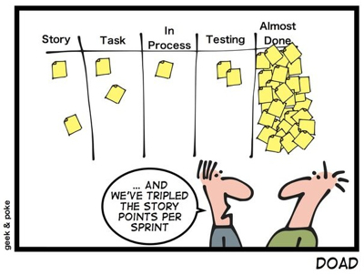
Problems Typical Approach Can Cause
Code is pushed to production environment

Slide 7
So Then What’s CI?
Continuous Integration (CI)
The process of constantly merging development with a master branch for testing (as in on a daily basis)
Continuous Delivery (CD)
The practice of automatically deploying code to internal systems for further testing as soon as committed changes have passed automated tests

Slide 8
The Basic Idea
Commit frequently to reduce merge issues
Automatically test each commit
Automatically create a production candidate build for each successfully tested commit
Deploy that build to necessary environments for manual testing
Deploy builds that pass manual testing to production

Slide 9
How Does This Help?
Automation and Risk Reduction!
Changes are smaller and thus less likely to break things
QA can have the confidence to test only the modified items instead of the whole product due to automated tests
Builds are already release candidates meaning if they pass testing they can be deployed as is
Promotes Test Driven Development (TDD) which helps ensure new code has automated tests

Slide 10
How About Taking It To The Extreme?
Continuous Deployment
The practice of automatically deploying code to production as soon as committed changes have passed automated tests
Basically removing manual testing from the picture
Automated tests have to be fantastic
Not for every situation, especially as bigger organizations usually need approvals in order to deploy

Slide 11
Relation to CSCI 577
A bit of overkill for our team projects due to the infrastructure taking a lot of time to set up
Most useful for continued development once the product has already been deployed to production (a.k.a. Post CSCI 577 Project)
However, once infrastructure is created, development can proceed at a fast pace with confidence

Slide 12
CI Tools Out There
The Big Names
Bamboo (Part of Atlassian Suite)
Jenkins (Originally Hudson)
Other Potential Options
CruiseControl
TeamCity

